Slide 1
Lecture 3: Business Intelligence:
OLAP, Data Warehouse, and
Column Store

Slide 2
Why we still study OLAP/Data Warehouse in Big Data?
Understand the Big Data history
  How does the requirement of (big) data analytics/business intelligence evolve over the time?
  What are the architecture and implementation techniques being developed? Will they still be useful in Big Data?
  Understand their limitation and what factors have changed from 90’s to now?
NoSQL is not only SQL☺
Hive/Impala aims to provide OLAP/BI for Big Data using Hadoop

Slide 3
Highlights
OLAP
  Multi-relational Data model
  Operators
  SQL
Data warehouse (architecture, issues, optimizations)
Join Processing
Column Stores (Optimized for OLAP workload)

Slide 4
Let’s get back to the root in 70’s: Relational Database

Slide 5
Basic Structure
Formally, given sets D₁, D₂, …. D_{n} a relation r is a subset of
D₁ x D₂ x … x D_{n}
Thus, a relation is a set of n-tuples (a₁, a₂, …, a_{n}) where each a_{i} ∈ D_{i}
Example:
customer_name = {Jones, Smith, Curry, Lindsay}
customer_street = {Main, North, Park}
customer_city = {Harrison, Rye, Pittsfield}
Then r = { (Jones, Main, Harrison),
(Smith, North, Rye),
(Curry, North, Rye),
(Lindsay, Park, Pittsfield) }
is a relation over
customer_name , customer_street, customer_city

Slide 6
Relation Schema
A₁, A₂, …, A_{n} are attributes
R = (A₁, A₂, …, A_{n} ) is a relation schema
Example:
Customer_schema = (customer_name, customer_street, customer_city)
r(R) is a relation on the relation schema R
Example:
customer (Customer_schema)

Slide 7
Relation Instance
The current values (relation instance) of a relation are specified by a table
An element t of r is a tuple, represented by a row in a table
attributes
(or columns)
customer_name
customer_street
customer_city
Jones
Smith
Curry
Lindsay
Main
North
North
Park
Harrison
Rye
Rye
Pittsfield
tuples
(or rows)
customer

Slide 8
Database
A database consists of multiple relations
Information about an enterprise is broken up into parts, with each relation storing one part of the information
account : stores information about accounts
depositor : stores information about which customer
owns which account
customer : stores information about customers
Storing all information as a single relation such as
bank(account_number, balance, customer_name, ..)
results in repetition of information (e.g., two customers own an account) and the need for null values (e.g., represent a customer without an account)

Slide 9
Banking Example
branch (branch-name, branch-city, assets)
customer (customer-name, customer-street, customer-city)
account (account-number, branch-name, balance)
loan (loan-number, branch-name, amount)
depositor (customer-name, account-number)
borrower (customer-name, loan-number)

Slide 10
Relational Algebra
Primitives
  Projection (π)
  Selection (σ)
  Cartesian product (×)
  Set union (∪)
  Set difference (−)
  Rename (ρ)
Other operations
  Join (⋈)
  Group by… aggregation
  …

Slide 11
What happens next?
SQL
System R (DB2), INGRES, ORACLE, SQL-Server, Teradata
  B+-Tree (select)
  Transaction Management
  Join algorithm

Slide 12
In early 90’s:
OLAP & Data Warehouse

Slide 13
Database Workloads
OLTP (online transaction processing)
  Typical applications: e-commerce, banking, airline reservations
  User facing: real-time, low latency, highly-concurrent
  Tasks: relatively small set of “standard” transactional queries
  Data access pattern: random reads, updates, writes (involving relatively small amounts of data)
OLAP (online analytical processing)
  Typical applications: business intelligence, data mining
  Back-end processing: batch workloads, less concurrency
  Tasks: complex analytical queries, often ad hoc
  Data access pattern: table scans, large amounts of data involved per query

Slide 14
OLTP
Most database operations involve On-Line Transaction Processing (OTLP).
  Short, simple, frequent queries and/or modifications, each involving a small number of tuples.
  Examples: Answering queries from a Web interface, sales at cash registers, selling airline tickets.

Slide 15
OLAP
Of increasing importance are On-Line Application Processing (OLAP) queries.
  Few, but complex queries --- may run for hours.
  Queries do not depend on having an absolutely up-to-date database.

Slide 16
OLAP Examples
Amazon analyzes purchases by its customers to come up with an individual screen with products of likely interest to the customer.
Analysts at Wal-Mart look for items with increasing sales in some region.

Slide 17
One Database or Two?
Downsides of co-existing OLTP and OLAP workloads
  Poor memory management
  Conflicting data access patterns
  Variable latency
Solution: separate databases
  User-facing OLTP database for high-volume transactions
  Data warehouse for OLAP workloads
  How do we connect the two?

Slide 18
OLTP/OLAP Architecture
OLTP
OLAP
ETL
(Extract, Transform, and Load)

Slide 19
OLTP/OLAP Integration
OLTP database for user-facing transactions
  Retain records of all activity
  Periodic ETL (e.g., nightly)
Extract-Transform-Load (ETL)
  Extract records from source
  Transform: clean data, check integrity, aggregate, etc.
  Load into OLAP database
OLAP database for data warehousing
  Business intelligence: reporting, ad hoc queries, data mining, etc.
  Feedback to improve OLTP services

Slide 20
The Data Warehouse
The most common form of data integration.
  Copy sources into a single DB (warehouse) and try to keep it up-to-date.
  Usual method: periodic reconstruction of the warehouse, perhaps overnight.
  Frequently essential for analytic queries.

Slide 21
Warehouse Architecture
Client
Client
Query & Analysis
Metadata
Warehouse
Integration
Source
Source
Source

Slide 22
Star Schemas
A star schema is a common organization for data at a warehouse. It consists of:
  Fact table : a very large accumulation of facts such as sales.
    Often “insert-only.”
  Dimension tables : smaller, generally static information about the entities involved in the facts.

Slide 23
Example: Star Schema
Suppose we want to record in a warehouse information about every beer sale: the bar, the brand of beer, the drinker who bought the beer, the day, the time, and the price charged.
The fact table is a relation:
Sales(bar, beer, drinker, day, time, price)

Slide 24
Example, Continued
The dimension tables include information about the bar, beer, and drinker “dimensions”:
Bars(bar, addr, license)
Beers(beer, manf)
Drinkers(drinker, addr, phone)

Slide 25
Visualization – Star Schema
Dimension Table (Bars)
Dimension Table (Drinkers)
Dimension Attrs.
Dependent Attrs.
Fact Table - Sales
Dimension Table (Beers)
Dimension Table (etc.)

Slide 26
Dimensions and Dependent Attributes
Two classes of fact-table attributes:
  Dimension attributes : the key of a dimension table.
  Dependent attributes : a value determined by the dimension attributes of the tuple.

Slide 27
Warehouse Models & Operators
Data Models
  relations
  stars & snowflakes
  cubes
Operators
  slice & dice
  roll-up, drill down
  pivoting
  other

Slide 28
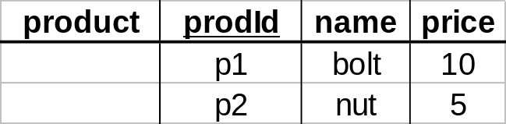
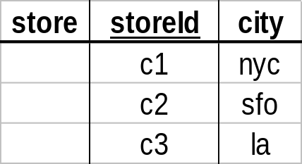
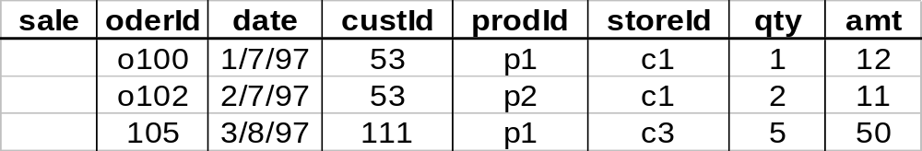
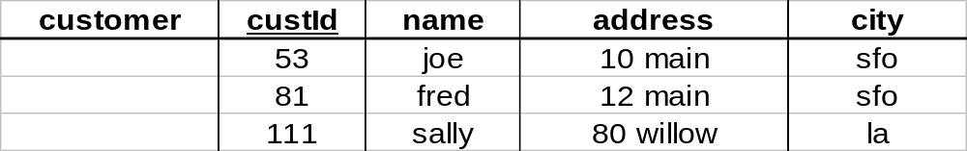
Star

Slide 29
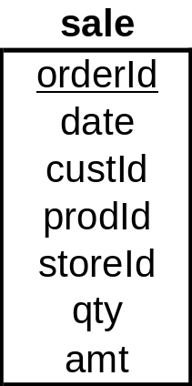
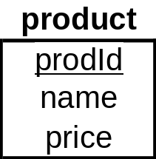
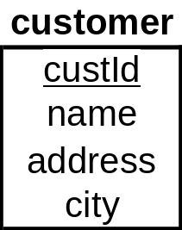
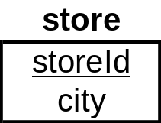
Star Schema

Slide 30
Terms
Fact table
Dimension tables
Measures

Slide 31
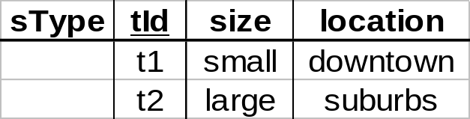
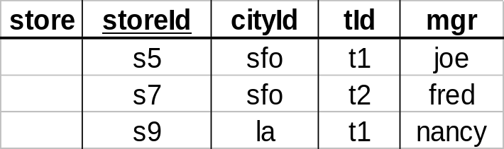
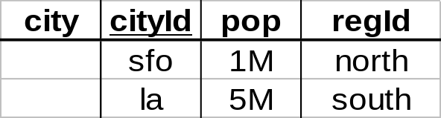
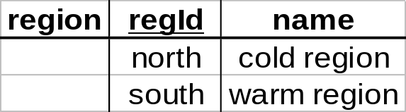
Dimension Hierarchies
sType
store
city
region
➔ snowflake schema
➔ constellations

Slide 32
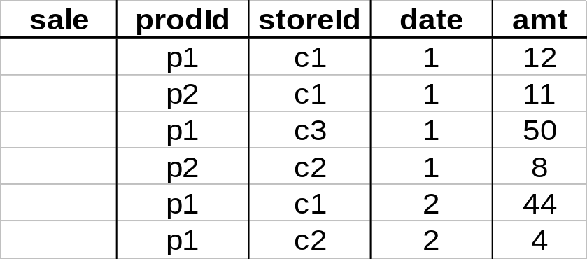
Aggregates
Add up amounts for day 1
In SQL: SELECT sum(amt) FROM SALE
WHERE date = 1
81

Slide 33
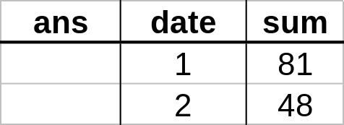
Aggregates
Add up amounts by day
In SQL: SELECT date, sum(amt) FROM SALE
GROUP BY date

Slide 34
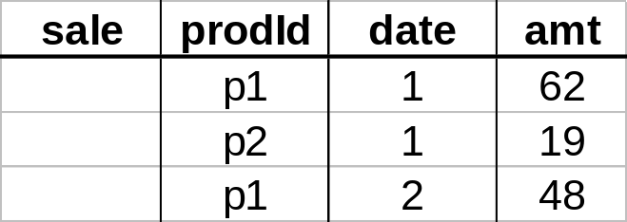
Another Example
Add up amounts by day, product
In SQL: SELECT date, sum(amt) FROM SALE
GROUP BY date, prodId
rollup
drill-down

Slide 35
ROLAP vs. MOLAP
ROLAP:
Relational On-Line Analytical Processing
MOLAP:
Multi-Dimensional On-Line Analytical Processing

Slide 36
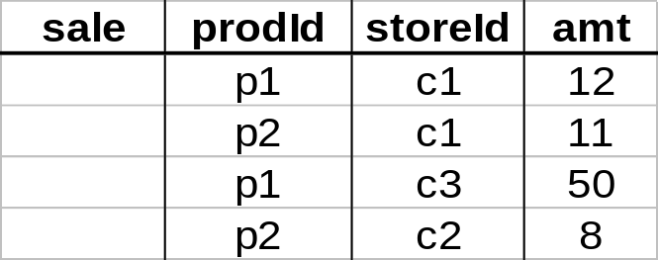
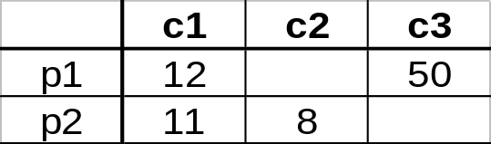
Cube
Fact table view:
Multi-dimensional cube:
dimensions = 2

Slide 37
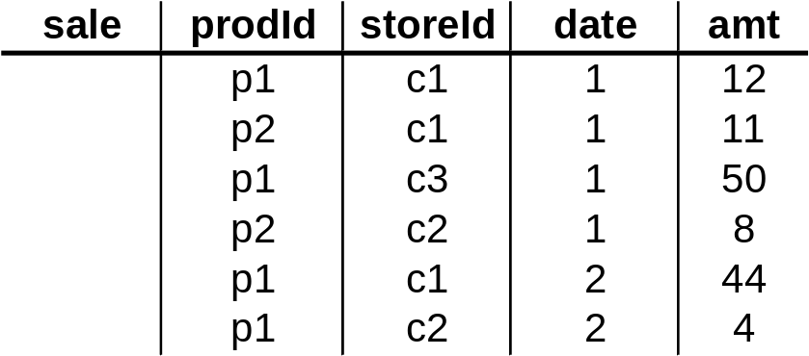
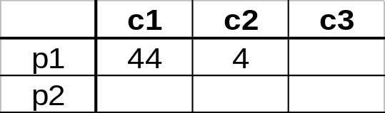
3-D Cube
Fact table view:
Multi-dimensional cube:
day 2
day 1
dimensions = 3

Slide 38
Multidimensional Data
Sales volume as a function of product, month, and region
Dimensions: Product, Location, Time
Hierarchical summarization paths
Region
Industry Region Year
Category Country Quarter
Product City Month Week
Office Day
Product
Month

Slide 39

A Sample Data Cube
Date
Total annual sales
of TV in U.S.A.
1Qtr
2Qtr
3Qtr
4Qtr
sum
Product
TV
PC
U.S.A
VCR
sum
Canada
Country
Mexico
sum
All, All, All

Slide 40
Cuboids Corresponding to the Cube
all
0-D(apex) cuboid
product
date
country
1-D cuboids
product,date
product,country
date, country
2-D cuboids
3-D(base) cuboid
product, date, country

Slide 41
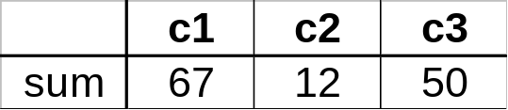
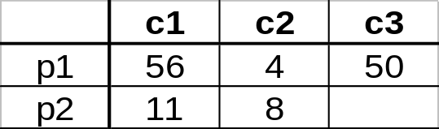
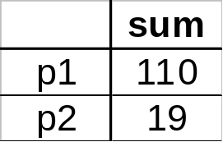
Cube Aggregation
Example: computing sums
day 2
. . .
day 1
129
rollup
drill-down

Slide 42
Cube Operators
day 2
. . .
day 1
sale(c1,*,*)
129
sale(c2,p2,*)
sale(*,*,*)

Slide 43
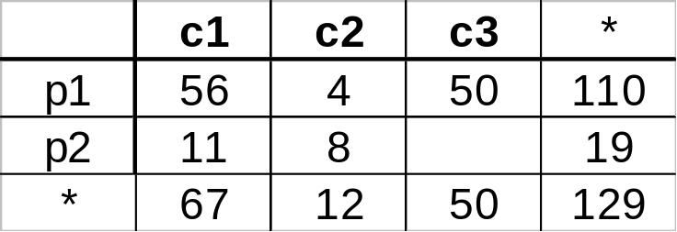
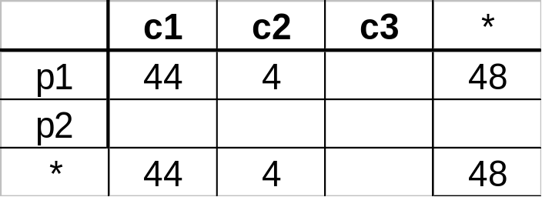
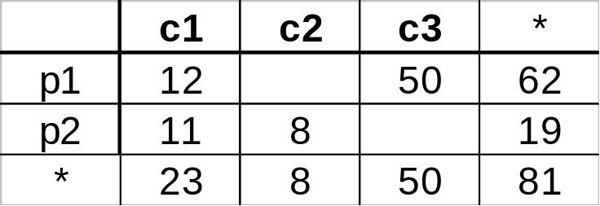
Extended Cube
*
day 2
sale(*,p2,*)
day 1

Slide 44
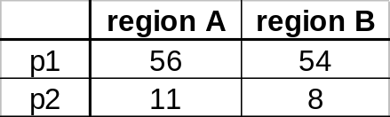
Aggregation Using Hierarchies
day 2
customer
day 1
region
country
(customer c1 in Region A;
customers c2, c3 in Region B)

Slide 45
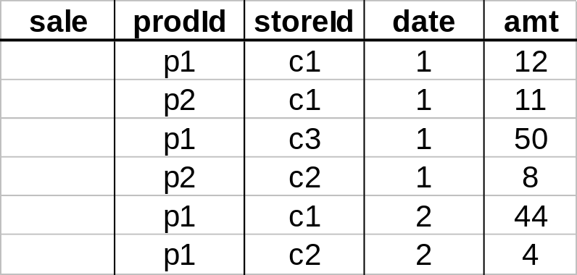
Pivoting
Fact table view:
Multi-dimensional cube:
day 2
day 1

Slide 46
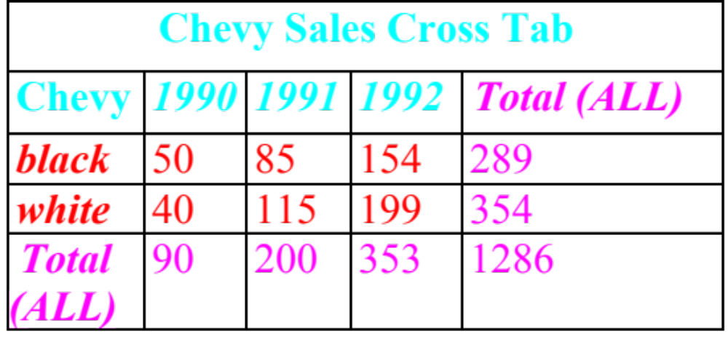
CUBE Operator (SQL-99)
SELECT model, year, color, sum(sales) as sales
FROM sales
WHERE model in (‘Chevy’)
AND year BETWEEN 1990 AND 1992
GROUP BY CUBE (model, year, color);

Slide 47
CUBE Contd.
  SELECT model, year, color, sum(sales) as sales
  FROM sales
  WHERE model in (‘Chevy’)
  AND year BETWEEN 1990 AND 1992
  GROUP BY CUBE (model, year, color);
Computes union of 8 different groupings:
  {(model, year, color), (model, year), (model, color), (year, color), (model), (year), (color), ()}

Slide 48
Example Contd.
CUBE

Slide 49
Aggregates
Operators: sum, count, max, min, median, ave
“Having” clause
Cube (& Rollup) operator
Using dimension hierarchy
  average by region (within store)
  maximum by month (within date)

Slide 50
Query & Analysis Tools
Query Building
Report Writers (comparisons, growth, graphs,…)
Spreadsheet Systems
Web Interfaces
Data Mining

Slide 51
Other Operations
Time functions
  e.g., time average
Computed Attributes
  e.g., commission = sales * rate
Text Queries
  e.g., find documents with words X AND B
  e.g., rank documents by frequency of
  words X, Y, Z

Slide 52
Data Warehouse Implementation

Slide 53
Implementing a Warehouse
Monitoring: Sending data from sources
Integrating: Loading, cleansing,...
Processing: Query processing, indexing, ...
Managing: Metadata, Design, ...

Slide 54
Multi-Tiered Architecture
Monitor
&
Integrator
OLAP Server
other
sources
Metadata
Analysis
Query
Reports
Data mining
Operational
DBs
Extract
Transform
Load
Refresh
Data
Warehouse
Serve
Data Marts
Data Sources
Data Storage
OLAP Engine
Front-End Tools

Slide 55
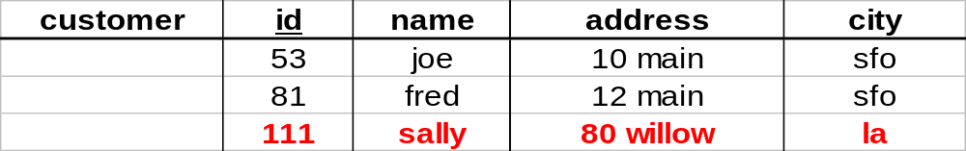
Monitoring
Source Types: relational, flat file, IMS, VSAM, IDMS, WWW, news-wire, …
Incremental vs. Refresh
new

Slide 56
Data Cleaning
Migration (e.g., yen ⇨ dollars)
Scrubbing: use domain-specific knowledge (e.g., social security numbers)
Fusion (e.g., mail list, customer merging)
Auditing: discover rules & relationships
(like data mining)
billing DB
customer1(Joe)
merged_customer(Joe)
service DB
customer2(Joe)

Slide 57
Loading Data
Incremental vs. refresh
Off-line vs. on-line
Frequency of loading
  At night, 1x a week/month, continuously
Parallel/Partitioned load

Slide 58
OLAP Implementation

Slide 59
Derived Data
Derived Warehouse Data
  indexes
  aggregates
  materialized views (next slide)
When to update derived data?
Incremental vs. refresh

Slide 60

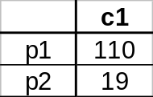
What to Materialize?
Store in warehouse results useful for common queries
Example:
total sales
day 2
. . .
day 1
129
materialize

Slide 61
Materialization Factors
Type/frequency of queries
Query response time
Storage cost
Update cost

Slide 62
Cube Aggregates Lattice
129
all
city
product
date
city, product
city, date
product, date
use greedy
algorithm to
decide what
to materialize
city, product, date
day 2
day 1

Slide 63
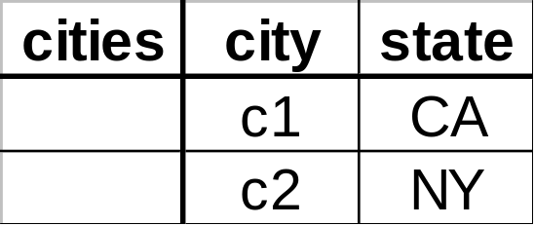
Dimension Hierarchies
all
state
city

Slide 64
Dimension Hierarchies
all
city
product
date
city, product
city, date
product, date
state
city, product, date
state, date
state, product
state, product, date
not all arcs shown...

Slide 65
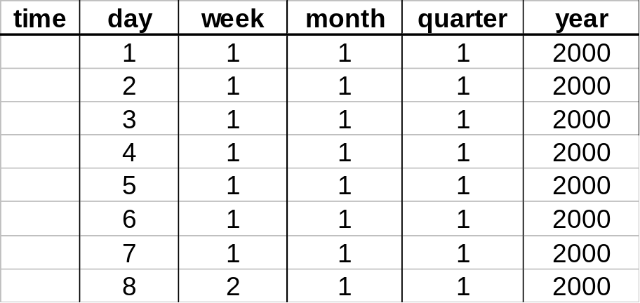
Interesting Hierarchy
all
years
weeks
quarters
months
conceptual
dimension table
days

Slide 66

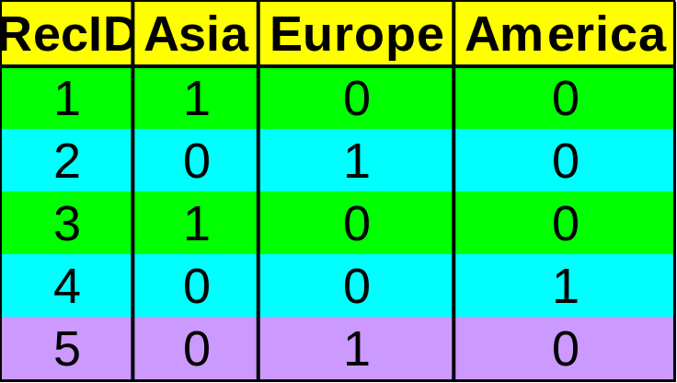

Indexing OLAP Data: Bitmap Index
Index on a particular column
Each value in the column has a bit vector: bit-op is fast
The length of the bit vector: # of records in the base table
The i-th bit is set if the i-th row of the base table has the value for the indexed column
not suitable for high cardinality domains
Base table
Index on Region
Index on Type

Slide 67
Join Processing

Slide 68
Join
How does DBMS join two tables?
Sorting is one way...
Database must choose best way for each query

Slide 69
Schema for Examples
Sailors (sid: integer, sname: string, rating: integer, age: real)
Reserves (sid: integer, bid: integer, day: dates, rname: string)
Similar to old schema; rname added for variations.
Reserves:
  Each tuple is 40 bytes long,
  100 tuples per page,
  M = 1000 pages total.
Sailors:
  Each tuple is 50 bytes long,
  80 tuples per page,
  N = 500 pages total.
Notes:
4

Slide 70

Equality Joins With One Join Column
SELECT *
FROM Reserves R1, Sailors S1
WHERE R1.sid=S1.sid
In algebra: R S. Common! Must be carefully optimized. R × S is large; so, R × S followed by a selection is inefficient.
Assume: M tuples in R, p_{R} tuples per page, N tuples in S, p_{S} tuples per page.
  In our examples, R is Reserves and S is Sailors.
We will consider more complex join conditions later.
Cost metric: # of I/Os. We will ignore output costs.
Notes:
5

Slide 71
Simple Nested Loops Join
foreach tuple r in R do
foreach tuple s in S do
if r_{i} == s_{j} then add <r, s> to result
For each tuple in the outer relation R, we scan the entire inner relation S.
  Cost: M + p_{R} * M * N = 1000 + 100*1000*500 I/Os.
Page-oriented Nested Loops join: For each page of R, get each page of S, and write out matching pairs of tuples <r, s>, where r is in R-page and S is in S-page.
  Cost: M + M*N = 1000 + 1000*500
  If smaller relation (S) is outer, cost = 500 + 500*1000
Notes:
6

Slide 72
Block Nested Loops Join
Use one page as an input buffer for scanning the inner S, one page as the output buffer, and use all remaining pages to hold ``block’’ of outer R.
  For each matching tuple r in R-block, s in S-page, add <r, s> to result. Then read next R-block, scan S, etc.
R & S
Join Result
Hash table for block of R
(k < B-1 pages)
. . .
. . .
. . .
Input buffer for S
Output buffer
Notes:
9

Slide 73
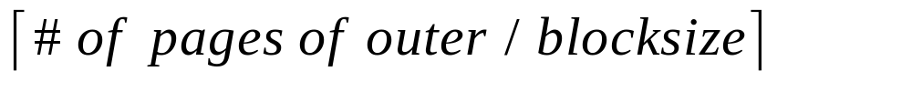
Examples of Block Nested Loops
Cost: Scan of outer + #outer blocks * scan of inner
  #outer blocks =
With Reserves (R) as outer, and 100 pages of R:
  Cost of scanning R is 1000 I/Os; a total of 10 blocks.
  Per block of R, we scan Sailors (S); 10*500 I/Os.
  If space for just 90 pages of R, we would scan S 12 times.
With 100-page block of Sailors as outer:
  Cost of scanning S is 500 I/Os; a total of 5 blocks.
  Per block of S, we scan Reserves; 5*1000 I/Os.
With sequential reads considered, analysis changes: may be best to divide buffers evenly between R and S.
Notes:
(# of pages of outer/ blocksize ) * total # of inner blocks
[Mathematical questions: what is the optimal I/O costs] What should be the page size; how should we decide the buffer size?

Slide 74
Index Nested Loops Join
foreach tuple r in R do
foreach tuple s in S where r_{i} == s_{j} do
add <r, s> to result
If there is an index on the join column of one relation (say S), can make it the inner and exploit the index.
  Cost: M + ( (M*p_{R}) * cost of finding matching S tuples)
For each R tuple, cost of probing S index is about 1.2 for hash index, 2-4 for B+ tree. Cost of then finding S tuples (assuming Alt. (2) or (3) for data entries) depends on clustering.
  Clustered index: 1 I/O (typical), unclustered: upto 1 I/O per matching S tuple.

Slide 75
Examples of Index Nested Loops
Hash-index (Alt. 2) on sid of Sailors (as inner):
  Scan Reserves: 1000 page I/Os, 100*1000 tuples.
  For each Reserves tuple: 1.2 I/Os to get data entry in index, plus 1 I/O to get (the exactly one) matching Sailors tuple. Total: 220,000 I/Os.
Hash-index (Alt. 2) on sid of Reserves (as inner):
  Scan Sailors: 500 page I/Os, 80*500 tuples.
  For each Sailors tuple: 1.2 I/Os to find index page with data entries, plus cost of retrieving matching Reserves tuples. Assuming uniform distribution, 2.5 reservations per sailor (100,000 / 40,000). Cost of retrieving them is 1 or 2.5 I/Os depending on whether the index is clustered.
Notes:
8

Slide 76

Sort-Merge Join (R S)
i=j
Sort R and S on the join column, then scan them to do a ``merge’’ (on join col.), and output result tuples.
  Advance scan of R until current R-tuple >= current S tuple, then advance scan of S until current S-tuple >= current R tuple; do this until current R tuple = current S tuple.
  At this point, all R tuples with same value in Ri (current R group) and all S tuples with same value in Sj (current S group) match; output <r, s> for all pairs of such tuples.
  Then resume scanning R and S.
R is scanned once; each S group is scanned once per matching R tuple. (Multiple scans of an S group are likely to find needed pages in buffer.)
Notes:
11

Slide 77
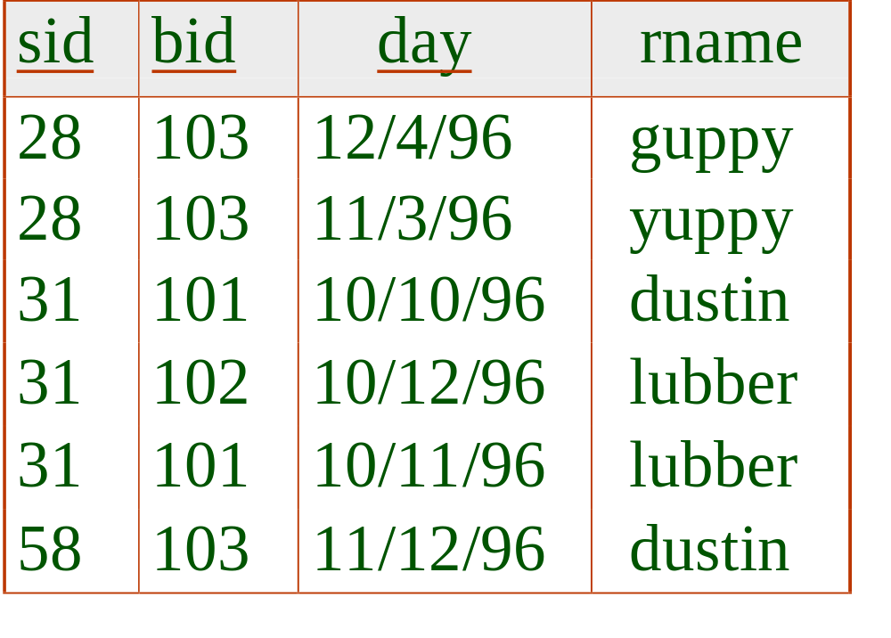
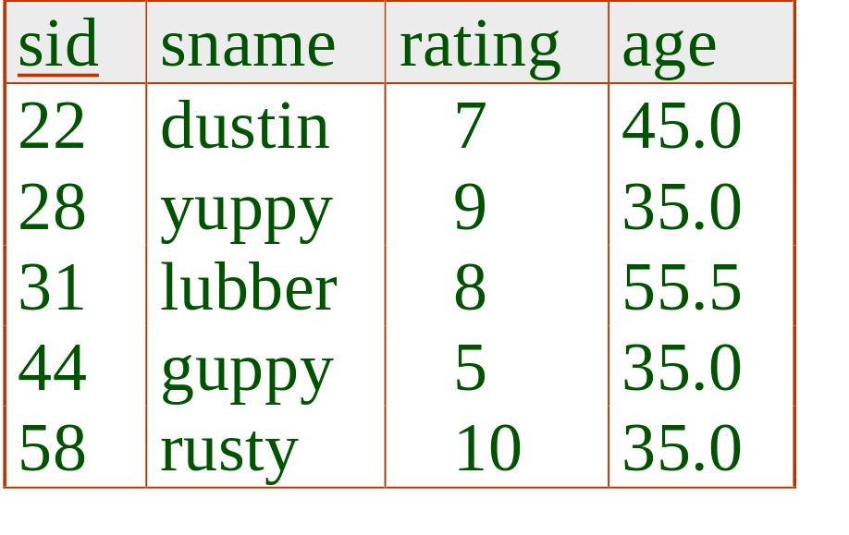
Example of Sort-Merge Join
Cost: M log M + N log N + (M+N)
  The cost of scanning, M+N, could be M*N (very unlikely!)
With 35, 100 or 300 buffer pages, both Reserves and Sailors can be sorted in 2 passes; total join cost: 7500.
(BNL cost: 2500 to 15000 I/Os)
Notes:
12

Slide 78
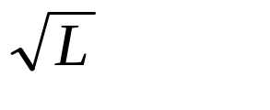
Refinement of Sort-Merge Join
We can combine the merging phases in the sorting of R and S with the merging required for the join.
  With B > , where L is the size of the larger relation, using the sorting refinement that produces runs of length 2B in Pass 0, #runs of each relation is < B/2.
  Allocate 1 page per run of each relation, and `merge’ while checking the join condition.
  Cost: read+write each relation in Pass 0 + read each relation in (only) merging pass (+ writing of result tuples).
  In example, cost goes down from 7500 to 4500 I/Os.
In practice, cost of sort-merge join, like the cost of external sorting, is linear.
Notes:
13

Slide 79
Hash-Join
Original
Relation
OUTPUT
Partitions
1
Partition both relations using hash fn h: R tuples in partition i will only match S tuples in partition i.
1
INPUT
2
hash
function
h
2
. . .
B-1
B-1
Disk
B main memory buffers
Disk
Partitions
of R & S
Join Result
Read in a partition of R, hash it using h2 (<> h!). Scan matching partition of S, search for matches.
Hash table for partition
Ri (k < B-1 pages)
hash
fn
h2
h2
Input buffer
for Si
Output
buffer
Disk
B main memory buffers
Disk
Notes:
14

Slide 80
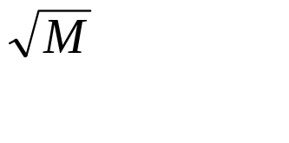
Observations on Hash-Join
#partitions k < B-1 (why?), and B-2 > size of largest partition to be held in memory. Assuming uniformly sized partitions, and maximizing k, we get:
  k= B-1, and M/(B-1) < B-2, i.e., B must be >
If we build an in-memory hash table to speed up the matching of tuples, a little more memory is needed.
If the hash function does not partition uniformly, one or more R partitions may not fit in memory. Can apply hash-join technique recursively to do the join of this R-partition with corresponding S-partition.
Notes:
15

Slide 81
Cost of Hash-Join
In partitioning phase, read+write both relns; 2(M+N). In matching phase, read both relns; M+N I/Os.
In our running example, this is a total of 4500 I/Os.
Sort-Merge Join vs. Hash Join:
  Given a minimum amount of memory (what is this, for each?) both have a cost of 3(M+N) I/Os. Hash Join superior on this count if relation sizes differ greatly. Also, Hash Join shown to be highly parallelizable.
  Sort-Merge less sensitive to data skew; result is sorted.
Notes:
16

Slide 82

Join Indices
Traditional indices map the values to a list of record ids
  It materializes relational join in JI file and speeds up relational join — a rather costly operation
In data warehouses, join index relates the values of the dimensions of a start schema to rows in the fact table.
  E.g. fact table: Sales and two dimensions city and product
    A join index on city maintains for each distinct city a list of R-IDs of the tuples recording the Sales in the city
  Join indices can span multiple dimensions

Slide 83
General Join Conditions
Equalities over several attributes (e.g., R.sid=S.sid AND R.rname=S.sname):
  For Index NL, build index on <sid, sname> (if S is inner); or use existing indexes on sid or sname.
  For Sort-Merge and Hash Join, sort/partition on combination of the two join columns.
Inequality conditions (e.g., R.rname < S.sname):
  For Index NL, need (clustered!) B+ tree index.
    Range probes on inner; # matches likely to be much higher than for equality joins.
  Hash Join, Sort Merge Join not applicable.
  Block NL quite likely to be the best join method here.

Slide 84
An invention in 2000s:
Column Stores for OLAP

Slide 85
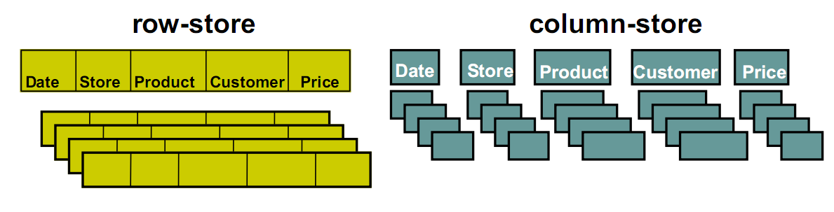
Row Store and Column Store
In row store data are stored in the disk tuple by tuple.
Where in column store data are stored in the disk column by column

Slide 86
Row Store vs Column Store
Column Store:
IBM 60.25 10,000 1/15/2006
MSFT 60.53 12,500 1/15/2006
Used in: Sybase IQ, Vertica
Row Store:
IBM 60.25 10,000 1/15/2006
MSFT 60.53 12,500 1/15/2006
Used in: Oracle, SQL Server, DB2, Netezza,…

Slide 87
Row Store and Column Store
For example the query
  SELECT account.account_number,
  sum (usage.toll_airtime),
  sum (usage.toll_price)
  FROM usage, toll, source, account
  WHERE usage.toll_id = toll.toll_id
  AND usage.source_id = source.source_id
  AND usage.account_id = account.account_id
  AND toll.type_ind in (‘AE’. ‘AA’)
  AND usage.toll_price > 0
  AND source.type != ‘CIBER’
  AND toll.rating_method = ‘IS’
  AND usage.invoice_date = 20051013
  GROUP BY account.account_number
Row-store: one row = 212 columns!
Column-store: 7 attributes

Slide 88
Row Store and Column Store
So column stores are suitable for read-mostly, read-intensive, large data repositories
Row Store | Column Store
(+) Easy to add/modify a record | (+) Only need to read in relevant data
(-) Might read in unnecessary data | (-) Tuple writes require multiple accesses

Slide 89
Column Stores: High Level
Read only what you need
  “Fat” fact tables are typical
  Analytics read only a few columns
Better compression
Execute on compressed data
Materialized views help row stores and column stores about equally

Slide 90
Data model (Vertica/C-Store)
Same as relational data model
  Tables, rows, columns
  Primary keys and foreign keys
  Projections
    From single table
    Multiple joined tables
Example
Possible C-store model
Normal relational model
EMP1 (name, age)
EMP2 (dept, age, DEPT.floor)
EMP3 (name, salary)
DEPT1(dname, floor)
EMP(name, age, dept, salary)
DEPT(dname, floor)

Slide 91

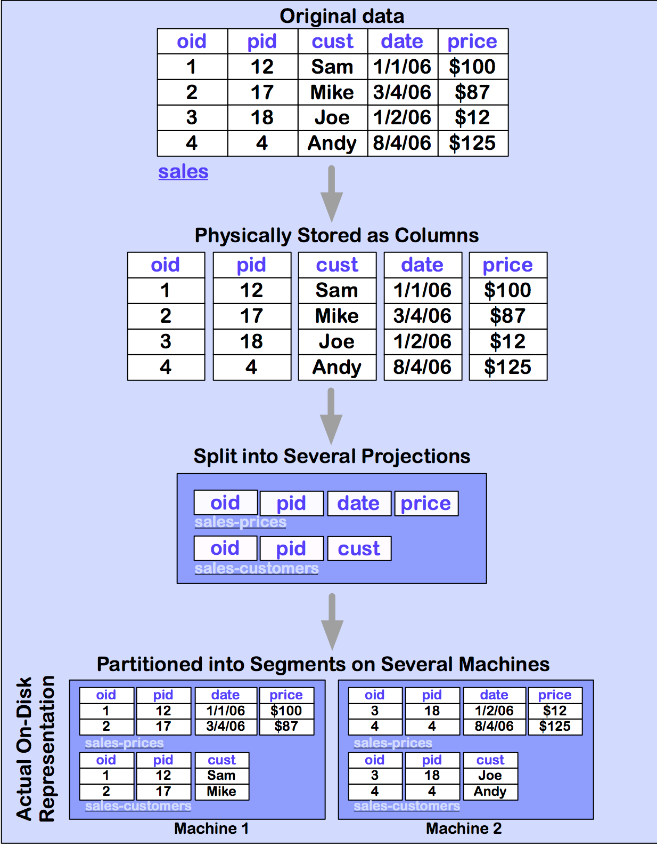


Slide 92
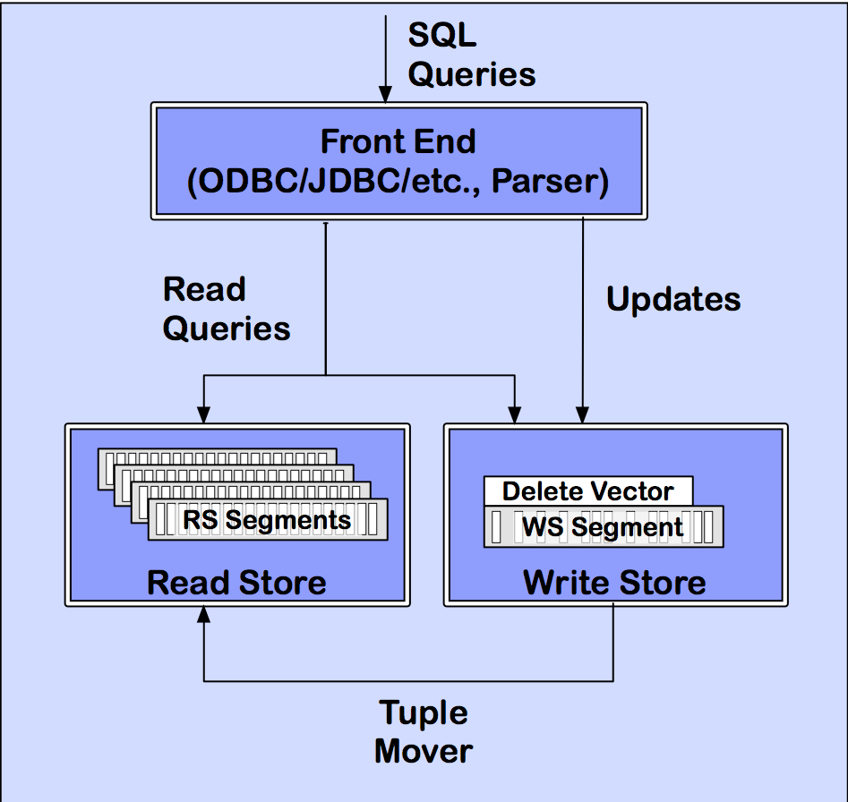
C-Store/Vertica Architecture
(from vertica Technical Overview White Paper)

Slide 93
Read store: Column Encoding/Compression
Use compression schemes and indices
  Null Suppression
  Dictionary encoding
  Run Length encoding
  Bit-Vector encoding
  Self-order (key), few distinct values
    (value, position, # items)
    Indexed by clustered B-tree
  Foreign-order (non-key), few distinct values
    (value, bitmap index)
    B-tree index: position → values
  Self-order, many distinct values
    Delta from the previous value
    B-tree index
  Foreign-order, many distinct values
    Unencoded

Slide 94
Compression
Trades I/O for CPU
  Increased column-store opportunities:
  Higher data value locality in column stores
  Techniques such as run length encoding far more useful

Slide 95
Write Store
Same structure, but explicitly use (segment, key) to identify records
  Easier to maintain the mapping
  Only concerns the inserted records
Tuple mover
  Copies batch of records to RS
Delete record
  Mark it on RS
  Purged by tuple mover

Slide 96
How to solve read/write conflict
Situation: one transaction updates the record X, while another transaction reads X.
Use snapshot isolation

Slide 97
Query Execution - Operators
Select: Same as relational algebra, but produces a bit string
Project: Same as relational algebra
Join: Joins projections according to predicates
Aggregation: SQL like aggregates
Sort: Sort all columns of a projection

Slide 98
Query Execution - Operators
Decompress: Converts compressed column to uncompressed representation
Mask(Bitstring B, Projection Cs) => emit only those values whose corresponding bits are 1
Concat: Combines one or more projections sorted in the same order into a single projection
Permute: Permutes a projection according to the ordering defined by a join index
Bitstring operators: Band – Bitwise AND, Bor – Bitwise OR, Bnot – complement

Slide 99
Benefits in query processing
Selection – has more indices to use
Projection – some “projections” already defined
Join – some projections are materialized joins
Aggregations – works on required columns only

Slide 100

Evaluation
Use TPC-H – decision support queries
Storage

Slide 101
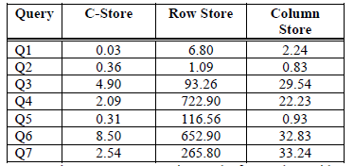
Query performance

Slide 102
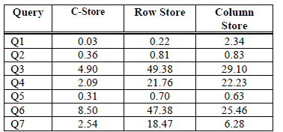
Query performance
Row store uses materialized views

Slide 103
Summary: the performance gain
Column representation – avoids reads of unused attributes
Storing overlapping projections – multiple orderings of a column, more choices for query optimization
Compression of data – more orderings of a column in the same amount of space
Query operators operate on compressed representation

Slide 104
Google’s Dremel:
Interactive Analysis of Web-Scale Datasets

Slide 105
Dremel system
Trillion-record, multi-terabyte datasets at interactive speed
  Scales to thousands of nodes
  Fault and straggler tolerant execution
Nested data model
  Complex datasets; normalization is prohibitive
  Columnar storage and processing
Tree architecture (as in web search)
Interoperates with Google's data mgmt tools
  In situ data access (e.g., GFS, Bigtable)
  MapReduce pipelines

Slide 106
Widely used inside Google
Analysis of crawled web documents
Tracking install data for applications on Android Market
Crash reporting for Google products
OCR results from Google Books
Spam analysis
Debugging of map tiles on Google Maps
Tablet migrations in managed Bigtable instances
Results of tests run on Google's distributed build system
Disk I/O statistics for hundreds of thousands of disks
Resource monitoring for jobs run in Google's data centers
Symbols and dependencies in Google's codebase

Slide 107




Records vs. columns
r₁
DocId: 10
Links
Forward: 20
Name
Language
Code: 'en-us'
Country: 'us'
Url: 'http://A'
Name
Url: 'http://B'
A
*
*
B
. . .
E
*
C
D
r₁
r₁
r₁
r₁
r₂
r₂
r₂
Read less,
cheaper
decompression
r₂
. . .
Challenge: preserve structure, reconstruct from a subset of fields

Slide 108
Nested data model
http://code.google.com/apis/protocolbuffers
r₁
DocId: 10
Links
Forward: 20
Forward: 40
Forward: 60
Name
Language
Code: 'en-us'
Country: 'us'
Language
Code: 'en'
Url: 'http://A'
Name
Url: 'http://B'
Name
Language
Code: 'en-gb'
Country: 'gb'
multiplicity:
message Document {
required int64 DocId; [1,1]
optional group Links {
repeated int64 Backward; [0,*]
repeated int64 Forward;
}
repeated group Name {
repeated group Language {
required string Code;
optional string Country; [0,1]
}
optional string Url;
}
}
r₂
DocId: 20
Links
Backward: 10
Backward: 30
Forward: 80
Name
Url: 'http://C'

Slide 109
Column-striped representation
DocId
Name.Url
Links.Forward
Links.Backward
value | r | d
10 | 0 | 0
20 | 0 | 0
value | r | d
http://A | 0 | 2
http://B | 1 | 2
NULL | 1 | 1
http://C | 0 | 2
value | r | d
20 | 0 | 2
40 | 1 | 2
60 | 1 | 2
80 | 0 | 2
value | r | d
NULL | 0 | 1
10 | 0 | 2
30 | 1 | 2
Name.Language.Code
Name.Language.Country
value | r | d
en-us | 0 | 2
en | 2 | 2
NULL | 1 | 1
en-gb | 1 | 2
NULL | 0 | 1
value | r | d
us | 0 | 3
NULL | 2 | 2
NULL | 1 | 1
gb | 1 | 3
NULL | 0 | 1

Slide 110
Repetition and definition levels
r₁
DocId: 10
Links
Forward: 20
Forward: 40
Forward: 60
Name
Language
Code: 'en-us'
Country: 'us'
Language
Code: 'en'
Url: 'http://A'
Name
Url: 'http://B'
Name
Language
Code: 'en-gb'
Country: 'gb'
r=1
r=2
(non-repeating)
Name.Language.Code
value | r | d
en-us | 0 | 2
en | 2 | 2
NULL | 1 | 1
en-gb | 1 | 2
NULL | 0 | 1
record (r=0) has repeated
Language (r=2) has repeated
r: At what repeated field in the field's path
the value has repeated
r₂
DocId: 20
Links
Backward: 10
Backward: 30
Forward: 80
Name
Url: 'http://C'
d: How many fields in paths that could be
undefined (opt. or rep.) are actually present

Slide 111
Query processing
Optimized for select-project-aggregate
  Very common class of interactive queries
  Single scan
  Within-record and cross-record aggregation
Approximations: count(distinct), top-k
Joins, temp tables, UDFs/TVFs, etc.

Slide 112
SQL dialect for nested data
SELECT DocId AS Id,
COUNT(Name.Language.Code) WITHIN Name AS Cnt,
Name.Url + ',' + Name.Language.Code AS Str
FROM t
WHERE REGEXP(Name.Url, '^http') AND DocId < 20;
Output table
Output schema
t₁
Id: 10
Name
Cnt: 2
Language
Str: 'http://A,en-us'
Str: 'http://A,en'
Name
Cnt: 0
message QueryResult {
required int64 Id;
repeated group Name {
optional uint64 Cnt;
repeated group Language {
optional string Str;
}
}
}

Slide 113


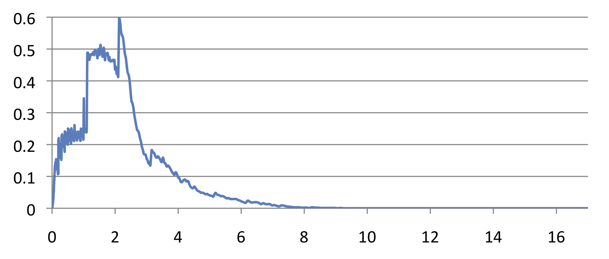
Serving tree
[Dean WSDM'09]
client
Parallelizes scheduling and aggregation
Fault tolerance
Stragglers
Designed for "small" results (<1M records)
root server
intermediate
servers
. . .
. . .
leaf servers
(with local
storage)
. . .
histogram of
response times
storage layer (e.g., GFS)

Slide 114
Example: count()
SELECT A, COUNT(B) FROM T GROUP BY A
T = {/gfs/1, /gfs/2, …, /gfs/100000}
SELECT A, SUM(c)
FROM (R₁1 UNION ALL R₁10)
GROUP BY A
0
R₁1
R₁2
SELECT A, COUNT(B) AS c
FROM T₁1 GROUP BY A
T₁1 = {/gfs/1, …, /gfs/10000}
SELECT A, COUNT(B) AS c
FROM T₁2 GROUP BY A
T₁2 = {/gfs/10001, …, /gfs/20000}
1
. . .
. . .
SELECT A, COUNT(B) AS c
FROM T₃1 GROUP BY A
T₃1 = {/gfs/1}
. . .
3
Data access ops

Slide 115
Experiments
1 PB of real data
(uncompressed, non-replicated)
100K-800K tablets per table
Experiments run during business hours
Table name | Number of records | Size (unrepl., compressed) | Number of fields | Data center | Repl. factor
T1 | 85 billion | 87 TB | 270 | A | 3×
T2 | 24 billion | 13 TB | 530 | A | 3×
T3 | 4 billion | 70 TB | 1200 | A | 3×
T4 | 1+ trillion | 105 TB | 50 | B | 3×
T5 | 1+ trillion | 20 TB | 30 | B | 2×

Slide 116
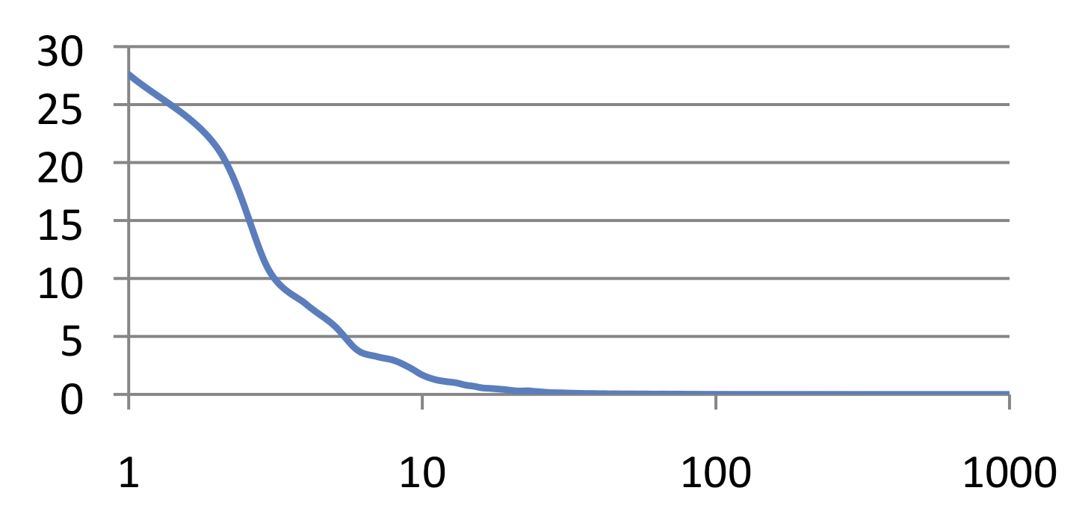
Interactive speed
Monthly query workload
of one 3000-node Dremel instance
percentage of queries
execution time (sec)
Most queries complete under 10 sec

Slide 117







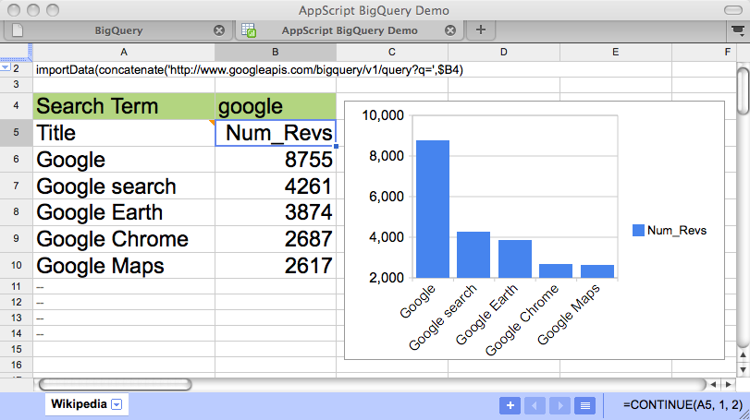

BigQuery: powered by Dremel
http://code.google.com/apis/bigquery/
Your Data
Upload your data
to Google Storage
1. Upload
BigQuery
2. Process
Import to tables
Your Apps
3. Act
Run queries

Slide 118
List of Column Databases
Vertica/C-Store
SybaseIQ
MonetDB
LucidDB
HANA
Google’s Dremel
Parcell-> Redshit (Another Cloud-DB Service)

Slide 119
Take-home messages
OLAP
  Multi-relational Data model
  Operators
  SQL
Data warehouse (architecture, issues, optimizations)
Join Processing
Column Stores (Optimized for OLAP workload)

